Slide 1
IoT Based Smart Irrigation System Group: 3
Kiran Anto Sebastian
Jerin Joy
Shinu Raj

Slide 2
Task
Water Pump system integration

Slide 3
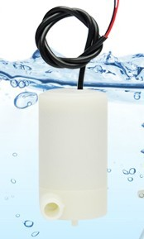
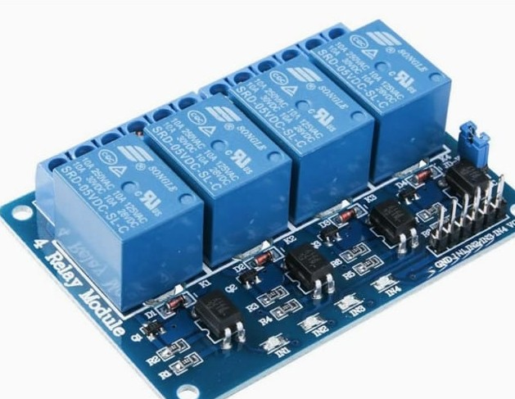
integrants
DC pump, 3v
DC 5V Relay Module

Slide 4
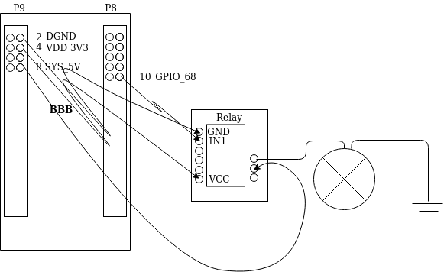
Connection Diagram

Slide 5
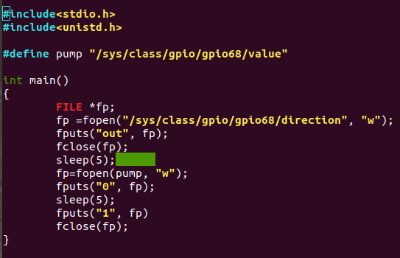
Code

Slide 6
Reference
BeagleBone.org Foundation (2019, 26 August), BeagleBone Black Wireless, Retrieved from https://beagleboard.org/black-wireless
Shenzhen Elegoo Technology (2019 September), ELEGOO 4 Channel DC 5V Relay Module with Optocoupler, Retrieved from https://www.elegoo.com/product/elegoo-4-channel-dc-5v-relay-module-with-optocoupler/
Gikfun.com (2019, 22 December), Automatic Watering System With Soil Moisture Sensor Diy Kit, Retrieved from http://www.gikfun.com/electronic-diy-kits-c-7/automatic-watering-system-with-soil-moisture-sensor-diy-kit-p-828.html

